Slide 1
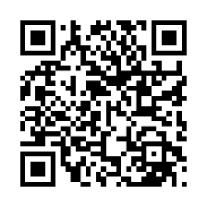
Schedule your biometric screening today!
Know where you stand
A biometric screening is an easy way to get important health numbers like your cholesterol levels and blood pressure, and it helps keep track of your health over time.
Earn [XX] when you complete a biometric screening by [Date XX].
How do I get a biometric screening?
• Sign up for an onsite screening at your location.
• Go to a participating lab, like Labcorp or CVS MinuteClinic.
• Request a home test kit.
• Make an appointment with your healthcare provider.
Learn more: Visit member.virginpulse.com and go to your Benefits page or scan the QR code to open in your app.
Client Logo
0923
© Virgin Pulse 2023

