Slide 1
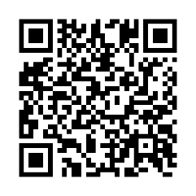
Client logo
Get a snapshot of your health
A biometric screening is a quick way to get a better picture of your health.
Earn [XX] when you complete a biometric screening by [Date XX].
Learn more: Visit member.virginpulse.com and go to your Benefits page or scan the QR code to open in your app.
Schedule your biometric screening today!
© Virgin Pulse 2023
0823

