Slide 1
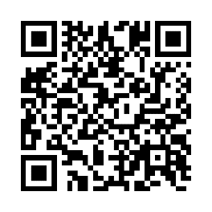
Schedule your biometric screening today!
Get a snapshot of your health
Earn [XX] when you complete a biometric screening by [Date XX].
A biometric screening is a quick way to get a better picture of your health. You’ll learn important numbers like your cholesterol levels and blood pressure, and it helps keep track of your health over time.
Learn more: Visit member.virginpulse.com and go to your Benefits page or scan the QR code to open in your app.
How do I get a biometric screening?
• Sign up for an onsite screening at your location.
• Go to a participating lab, like Labcorp or CVS MinuteClinic.
• Request a home test kit.
• Make an appointment with your healthcare provider.
Client Logo
0823
© Virgin Pulse 2023

