Slide 1
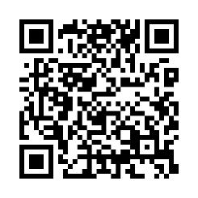
Client logo
Don’t miss a moment
Make your goals a reality by putting your health first. Learn about any health risks or changes from year to year with a biometric screening.
Earn [XX] when you complete a biometric screening by [Date XX].
Learn more: Visit member.virginpulse.com and go to your Benefits page or scan the QR code to open in your app.
Schedule your biometric screening today!
© Virgin Pulse 2023
0923

