Slide 1
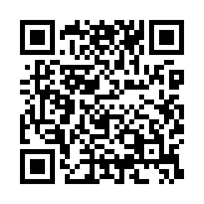
Schedule your biometric screening today!
Don’t miss a moment
What’s on your bucket list? Make your goals a reality by putting your health and wellbeing first. A biometric screening is a powerful tool that can alert you to any possible health risks or changes in your health from year to year. You’ll learn important numbers like blood pressure and cholesterol.
Earn [XX] when you complete a biometric screening by [Date XX].
Learn more: Visit member.virginpulse.com and go to your Benefits page or scan the QR code to open in your app.
How do I get a biometric screening?
• Sign up for an onsite screening at your location.
• Go to a participating lab, like Labcorp or CVS MinuteClinic.
• Request a home test kit.
• Make an appointment with your healthcare provider.
Client Logo
0923
© Virgin Pulse 2023

