Slide 1
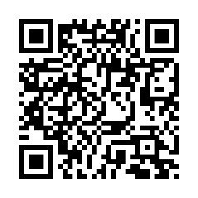
Client logo
Be there when it matters
You want to be there, at your best, for all the special moments ahead. A biometric screening can help you track changes in your health from year to year.
Earn [XX] when you complete a biometric screening by [Date XX].
Learn more: Visit member.virginpulse.com and go to your Benefits page or scan the QR code to open in your app.
Schedule your biometric screening today!
© Virgin Pulse 2023
0923

