Slide 1
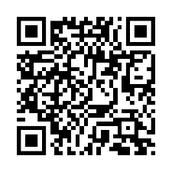
Schedule your biometric screening today!
Be there when it matters
You want to be there, at your best, for all the special moments ahead. A biometric screening can help you track changes in your health and learn important information like your blood pressure and cholesterol levels.
Earn [XX] when you complete a biometric screening by [Date XX].
Learn more: Visit member.virginpulse.com and go to your Benefits page or scan the QR code to open in your app.
How do I get a biometric screening?
• Sign up for an onsite screening at your location.
• Go to a participating lab, like Labcorp or CVS MinuteClinic.
• Request a home test kit.
• Make an appointment with your healthcare provider.
Client Logo
0923
© Virgin Pulse 2023

