Slide 1
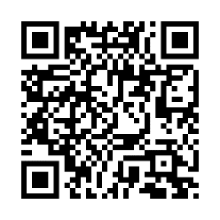
Schedule an onsite biometric screening!
Well, that’s convenient
You probably have a long to-do list, but this one’s easy. An onsite biometric screening is a quick and convenient way to check important health measures such as cholesterol, glucose and blood pressure. Knowing these numbers is key to getting you on the path to improved wellbeing.
When: [Enter date/time]
Where: [Enter location]
Earn [XX] when you complete a biometric screening by [Date XX].
Save your spot and learn more: Visit member.virginpulse.com and go to your Benefits page or scan the QR code to open in your app.
Client Logo
0923
© Virgin Pulse 2023

