Slide 1
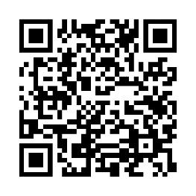
Schedule an onsite biometric screening!
It’s time well spent
An onsite biometric screening is a quick way to learn important health measures like cholesterol, glucose and blood pressure. Knowing these numbers helps keep track of your health over time.
When: [Enter date/time]
Where: [Enter location]
Earn [XX] when you complete a biometric screening by [Date XX].
Save your spot and learn more: Visit member.virginpulse.com and go to your Benefits page or scan the QR code to open in your app.
Client Logo
0823
© Virgin Pulse 2023

