Slide 1
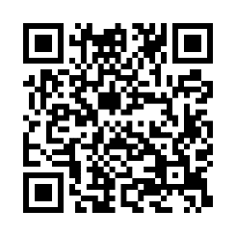
Client logo
Be there when it matters
Be there for all the special moments ahead.
Where: [Enter date/time]
When: [Enter location]
Earn [XX] when you complete a biometric screening by [Date XX].
Save your spot and learn more: Visit member.virginpulse.com and go to your Benefits page or scan the QR code to open in your app.
Schedule an onsite biometric screening!
© Virgin Pulse 2023
0923

