Slide 1
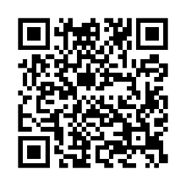
Schedule an onsite biometric screening!
Be there when it matters
You want to be there, at your best, for all the special moments ahead. A biometric screening can help you track changes in your health and learn important information like your blood pressure and cholesterol levels.
When: [Enter date/time]
Where: [Enter location]
Save your spot and learn more: Visit member.virginpulse.com and go to your Benefits page or scan the QR code to open in your app.
Earn [XX] when you complete a biometric screening by [Date XX].
Client Logo
0923
© Virgin Pulse 2023

